Slide 1
Week 10th ’s Work Progress
By: Abdur Rehman

Slide 2
Results 1:
tuner.results_summary()
Best mean_squared_error So Far: 0.00020917445654049515
Total elapsed time: 03h 36m 17s
best_hp.values
{'input_delay_size': 9, 'activation_': 'relu', 'hidden_layers': 6, 'units_nodes_0': 48, 'units_nodes_1': 96, 'learning_rate': 0.01, 'units_nodes_2': 224, 'units_nodes_3': 192, 'units_nodes_4': 104, 'units_nodes_5': 48, 'units_nodes_6': 88, 'units_nodes_7': 200, 'units_nodes_8': 192, 'units_nodes_9': 232, 'units_nodes_10': 104, 'units_nodes_11': 40, 'units_nodes_12': 208, 'units_nodes_13': 240, 'units_nodes_14': 200, 'units_nodes_15': 240, 'units_nodes_16': 144, 'units_nodes_17': 128, 'units_nodes_18': 224, 'shuffle': True, 'units_nodes_19': 208, 'units_nodes_20': 232, 'units_nodes_21': 48, 'units_nodes_22': 144, 'units_nodes_23': 160}
History TEST
loss | 0.00020971095364075154
mean_absolute_error | 0.008591593243181705
mean_squared_error | 0.00020971095364075154
root_mean_squared_error | 0.01448140013962984
History TRAIN
loss | 0.0001466529502067715
mean_absolute_error | 0.006720471661537886
mean_squared_error | 0.0001466529502067715
root_mean_squared_error | 0.012110034935176373

Slide 3
Model: "sequential_1"
_________________________________________________________________
Layer (type) Output Shape Param #
=================================================================
flatten_1 (Flatten) (None, 54) 0
dense_17 (Dense) (None, 48) 2640
dense_18 (Dense) (None, 96) 4704
dense_19 (Dense) (None, 224) 21728
dense_20 (Dense) (None, 192) 43200
dense_21 (Dense) (None, 104) 20072
dense_22 (Dense) (None, 48) 5040
dense_23 (Dense) (None, 4) 196
=================================================================
Total params: 97,580
Trainable params: 97,580
Non-trainable params: 0
_________________________________________________________________

Slide 4
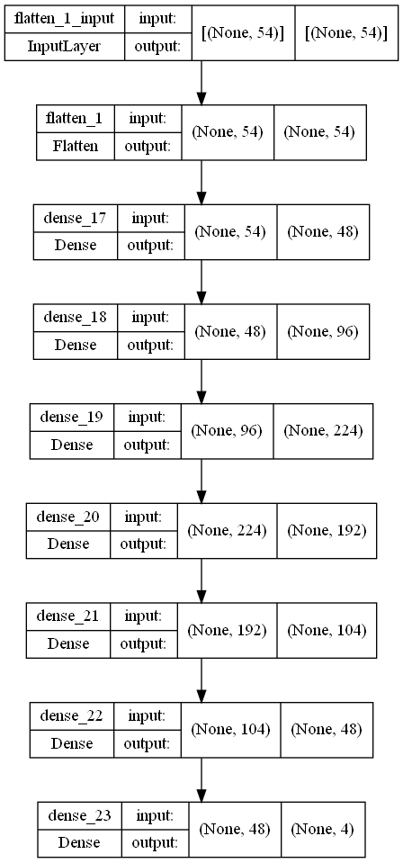

Slide 5
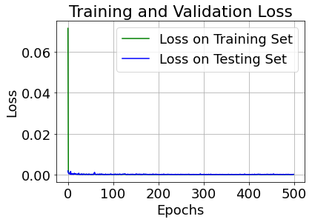
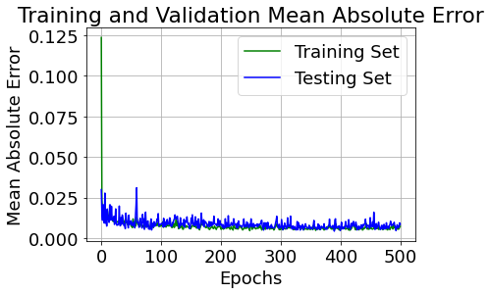

Slide 6
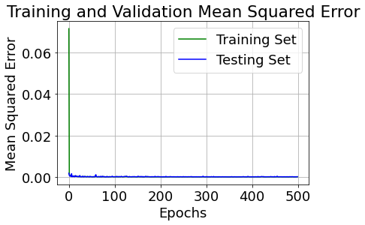
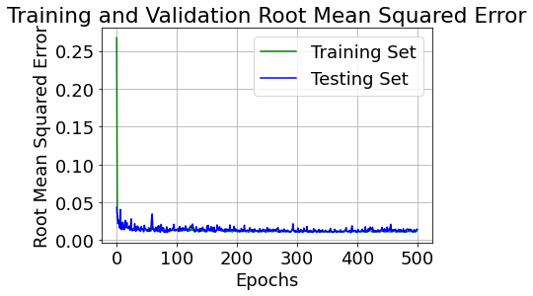

Slide 7
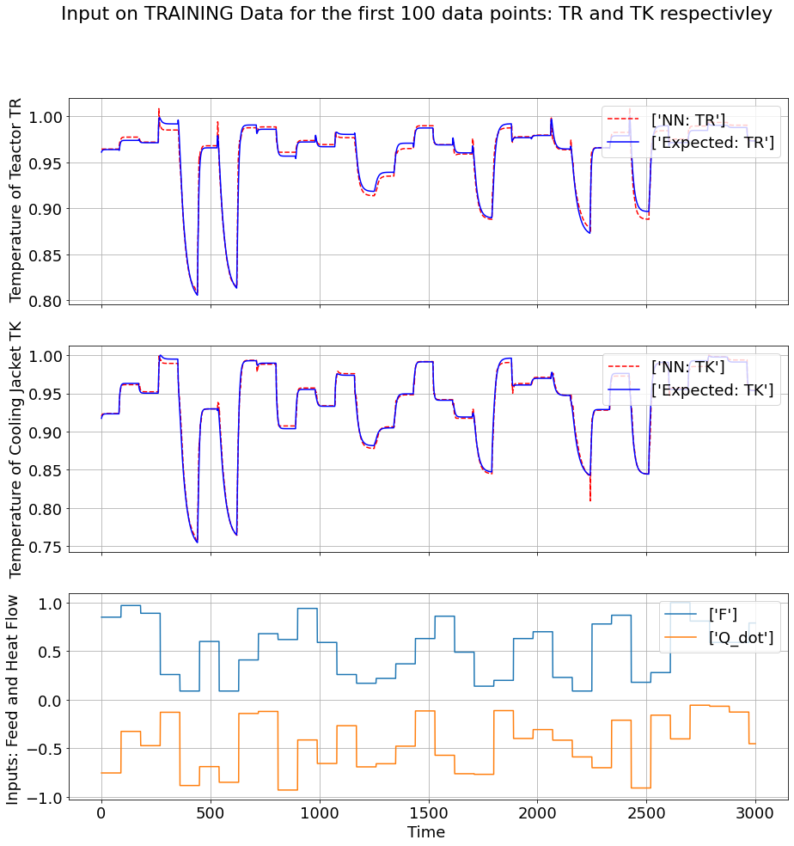

Slide 8
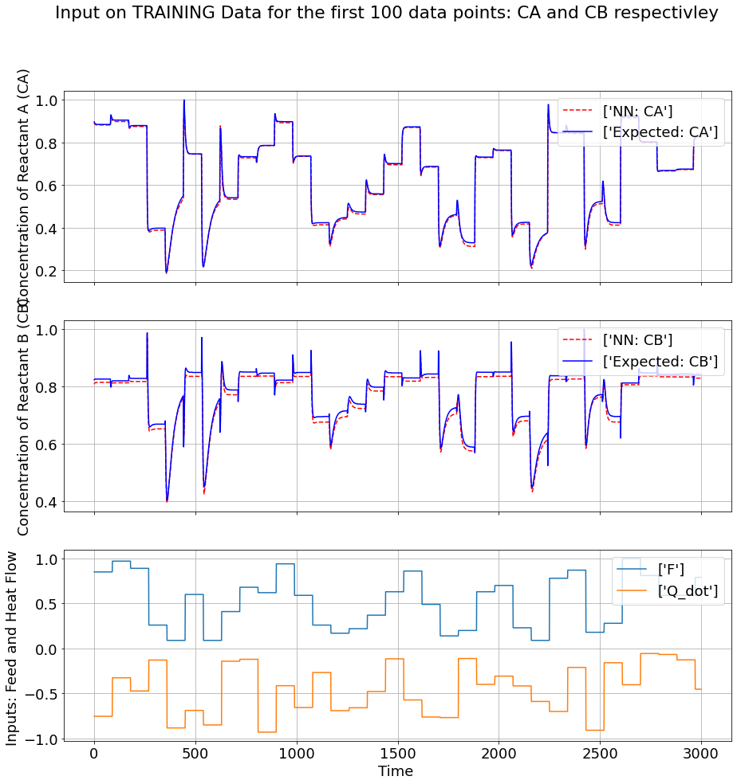

Slide 9
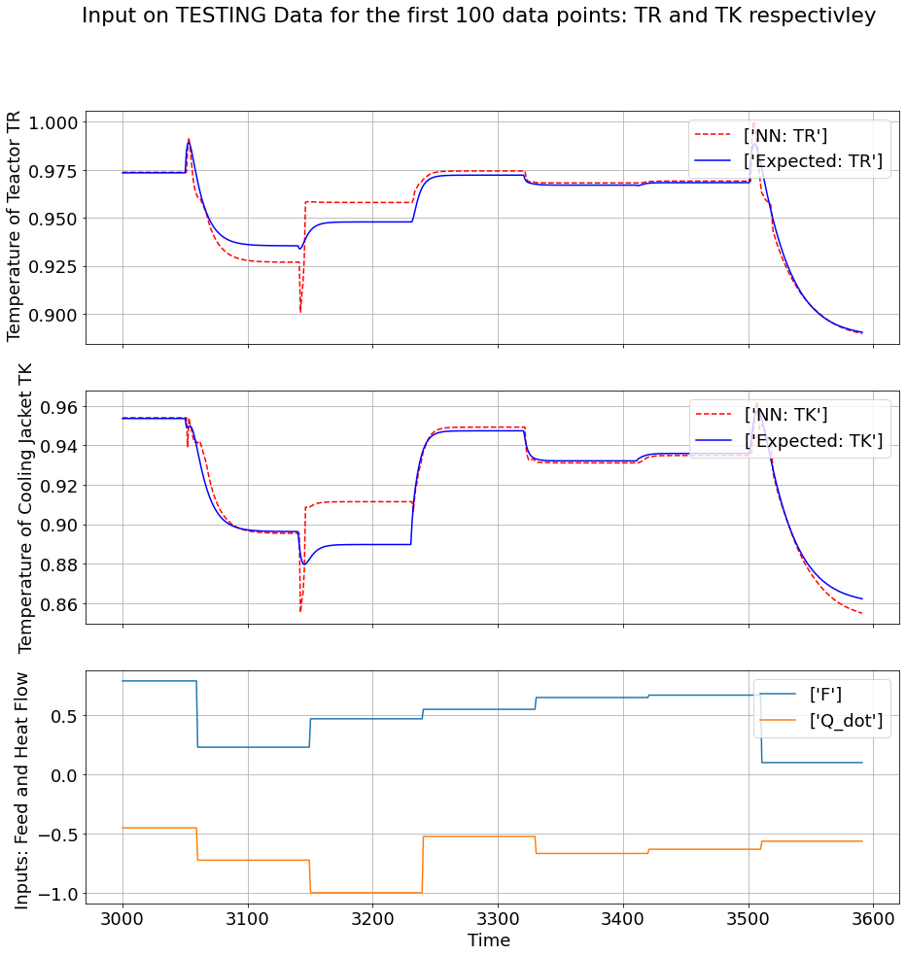

Slide 10
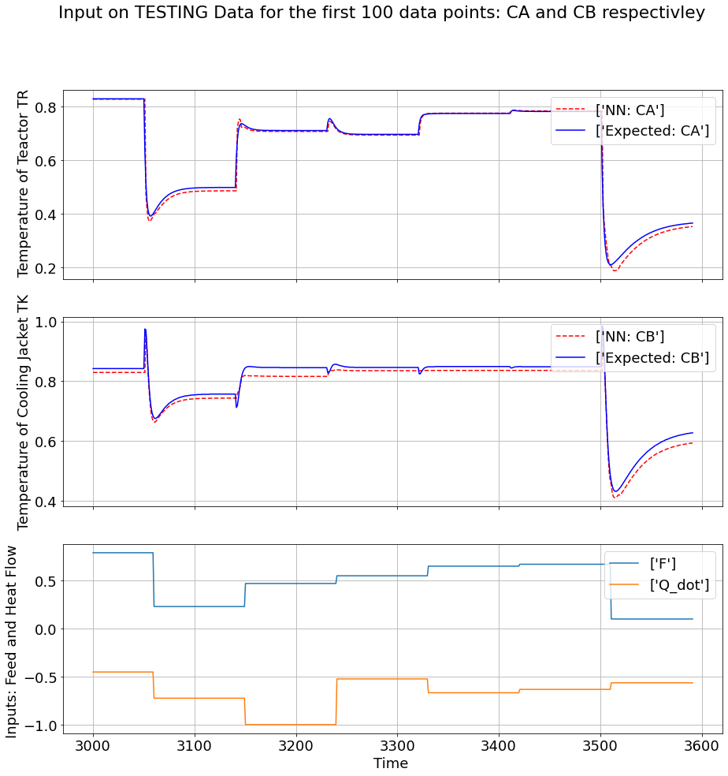

Slide 11
Physics Guided Neural Network

Slide 12
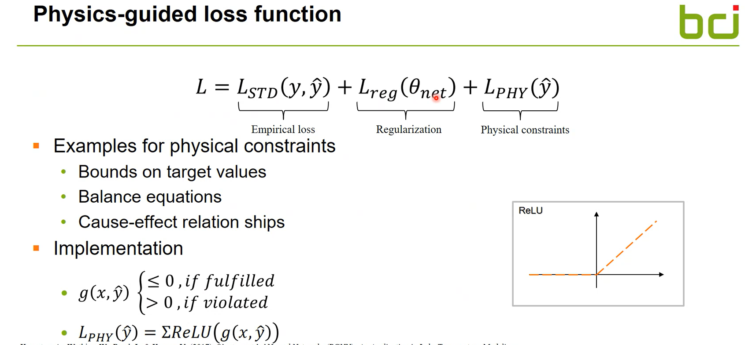

Slide 13
